Slide 1
IT TICKET ANALYSIS
ASHUTOSH KAR

Slide 2
INTRODUCTION
This project focuses on analyzing the IT support ticket management system to evaluate agent resolution process, the analysis aims to provide actionable insights.
These findings will support data-driven staffing decisions—such as hiring, firing, and training—ultimately enhancing service quality and team performance.

Slide 3
PROBLEM STATEMENT
The objective is to analyze the IT support ticket management system to understand the performance of IT agents, the efficiency of ticket resolution, and the satisfaction levels of employees.
The analysis aims to identify high and low performers among IT agents, assess the overall effectiveness of the team, and pinpoint areas for improvement in the ticket resolution process.
The ultimate goal is to make informed staffing decisions, including hiring, firing, and training, to enhance overall service quality and team performance.

Slide 4
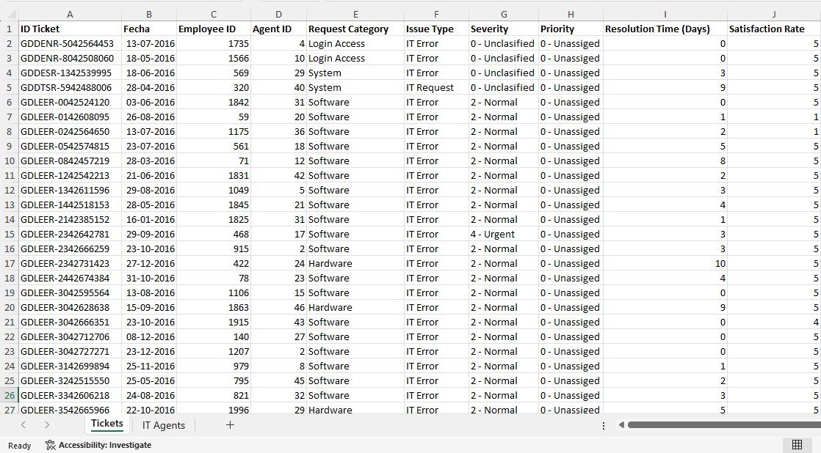
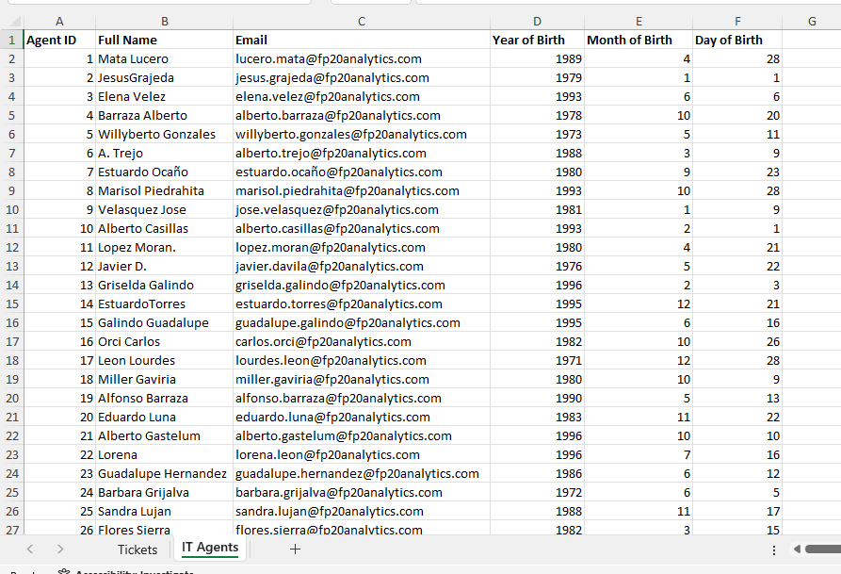
Data
OVERVIEW
The data of this project includes two excel sheets which consists data of IT Agents and IT Tickets.

Slide 5
Attributes of data tickets sheet
Tickets Sheet: Contains information about IT support tickets.
ID: Unique identifier for the ticket.
Ticket Fecha: Date of the ticket.
Employee ID: ID of the employee who raised the ticket.
Agent ID: ID of the agent assigned to the ticket.
Request Category: Category of the request (e.g., Login Access, System, Software).
Issue Type: Type of issue (e.g., IT Error, IT Request).
Severity: Severity of the issue.
Priority: Priority level of the issue
Resolution Time (Days): Time taken to resolve the ticket.
Satisfaction Rate: Satisfaction rate provided by the employee (1-5 scale).

Slide 6
Attributes of data it agents
IT Agents: Contains information about IT agents.
Agent ID: Unique identifier for the agent.
Full Name: Full name of the agent.
Email: Email address of the agent.
Year of Birth: Year the agent was born.
Month of Birth: Month the agent was born.
Day of Birth: Day the agent was born.

Slide 7
volume of ticket over time
Insights
The volume of tickets are steadily increasing over the past five years
Recommendations
Implement AI tools to intelligently route tickets to the most qualified agents based on expertise and availability, ensuring quicker resolution and higher quality service.
AI can also prioritize tickets, helping to address critical issues faster and more efficiently

Slide 8
Count of tickets by request category
Insights
The volume of tickets are steadily increasing over the past five years
Recommendations
Equip agents with faster, more reliable tools (e.g., high-performance computers, better networking equipment) to reduce delays and improve efficiency in handling complex tasks, especially hardware-related tickets.
issues faster and more efficiently

Slide 9
Tickets by resolution time
Insights
The volume of tickets are steadily increasing over the past five years
Recommendations
Use automation tools to handle repetitive tasks like ticket categorization or status updates, freeing up agents to focus on complex issues and speeding up resolution times. issues faster and more efficiently

Slide 10
SATISFACTION RATE OVER Years
Insights
The volume of tickets are steadily increasing over the past five years
Recommendations
Reallocate Agents Based on Ticket Volume and Complexity:
By tracking ticket volume and complexity, agents can be reassigned to areas with higher demand, ensuring tasks are handled by those with the right expertise. This helps balance workloads and prevents delays, improving resolution times, issues faster and more efficiently.

Slide 11
Insights
Agent performance varies significantly, with some agents taking longer resolution times despite moderate satisfaction scores.
Recommendations
Identify and support underperforming agents through targeted training to reduce resolution time and improve consistency issues faster and more efficiently.

Slide 12
Average resolution time by request category
Insights
Login access has taken the least amount of time to resolve whereas IT Agents are taking a lot of time to resolve hardware issues
Recommendations
Focus on training IT agents in resolving hardware issues efficiently and consider reallocating resources to reduce resolution time, leveraging the successful practices from login access cases. Issues faster and more efficiently

Slide 13
Age group by satisfaction rate
Insights
The average satisfaction rates among the senior agents are much higher and the middle-aged agents have the lowest satisfaction rates
Recommendations
Implement AI tools to intelligently route tickets to the most qualified agents based on expertise and availability, ensuring quicker resolution and higher quality service.
AI can also prioritize tickets, helping to address critical issues faster and more efficiently

Slide 14
Age group by satisfaction rate
Insights
Agents aged 35–44 handled the highest percentage of tickets (38%).
Recommendations
Consider retaining and upskilling the 35–44 age group, as they form the core of the ticket resolution workforce.
Encourage knowledge sharing from the experienced 35–44 age group to younger agents to balance performance across age groups.

Slide 15
Ticket by severity rate
Insights
Most of the tickets received from the IT agents have a severity rating of two
Recommendations
Use Analytics to Predict Demand and Adjust Staffing:
Analytics tools can forecast ticket trends, allowing for proactive staffing adjustments during peak times. This ensures the right number of agents are available, optimizing efficiency and preventing both overstaffing and understaffing, issues faster and more efficiently

Slide 16
Ticket by priority
Insights
Most of the tickets have a Priority rating of 3, which is the maximum rating.
Recommendations
Reducing agent workload stress by automating repetitive tasks, such as ticket categorization, allows agents to focus on more complex issues, improving job satisfaction.
Prioritizing faster resolution of critical tickets also enhances service delivery, boosting both employee morale and customer satisfaction. Efficient workflows lead to a more productive and satisfied team, benefiting everyone, issues faster and more efficiently.

Slide 17
Recommendations
Upgrade Hardware
Adopt Advanced Software
Equip agents with faster, more reliable tools (e.g., high-performance computers, better networking equipment) to reduce delays and improve efficiency in handling complex tasks, especially hardware-related tickets.
Use automation tools to handle repetitive tasks like ticket categorization or status updates, freeing up agents to focus on complex issues and speeding up resolution times.

Slide 18
Recommendations
AI-Driven Ticket Routing
Implement AI tools to intelligently route tickets to the most qualified agents based on expertise and availability, ensuring quicker resolution and higher quality service.
AI can also prioritize tickets, helping to address critical issues faster and more efficiently

Slide 19
Recommendations
Focus on Employee and Customer Satisfaction
Reducing agent workload stress by automating repetitive tasks, such as ticket categorization, allows agents to focus on more complex issues, improving job satisfaction.
Prioritizing faster resolution of critical tickets also enhances service delivery, boosting both employee morale and customer satisfaction. Efficient workflows lead to a more productive and satisfied team, benefiting everyone.

Slide 20
Recommendations
Optimize Resource Allocation
1. Reallocate Agents Based on Ticket Volume and Complexity:
By tracking ticket volume and complexity, agents can be reassigned to areas with higher demand, ensuring tasks are handled by those with the right expertise. This helps balance workloads and prevents delays, improving resolution times.
2. Use Analytics to Predict Demand and Adjust Staffing:
Analytics tools can forecast ticket trends, allowing for proactive staffing adjustments during peak times. This ensures the right number of agents are available, optimizing efficiency and preventing both overstaffing and understaffing.

Slide 21
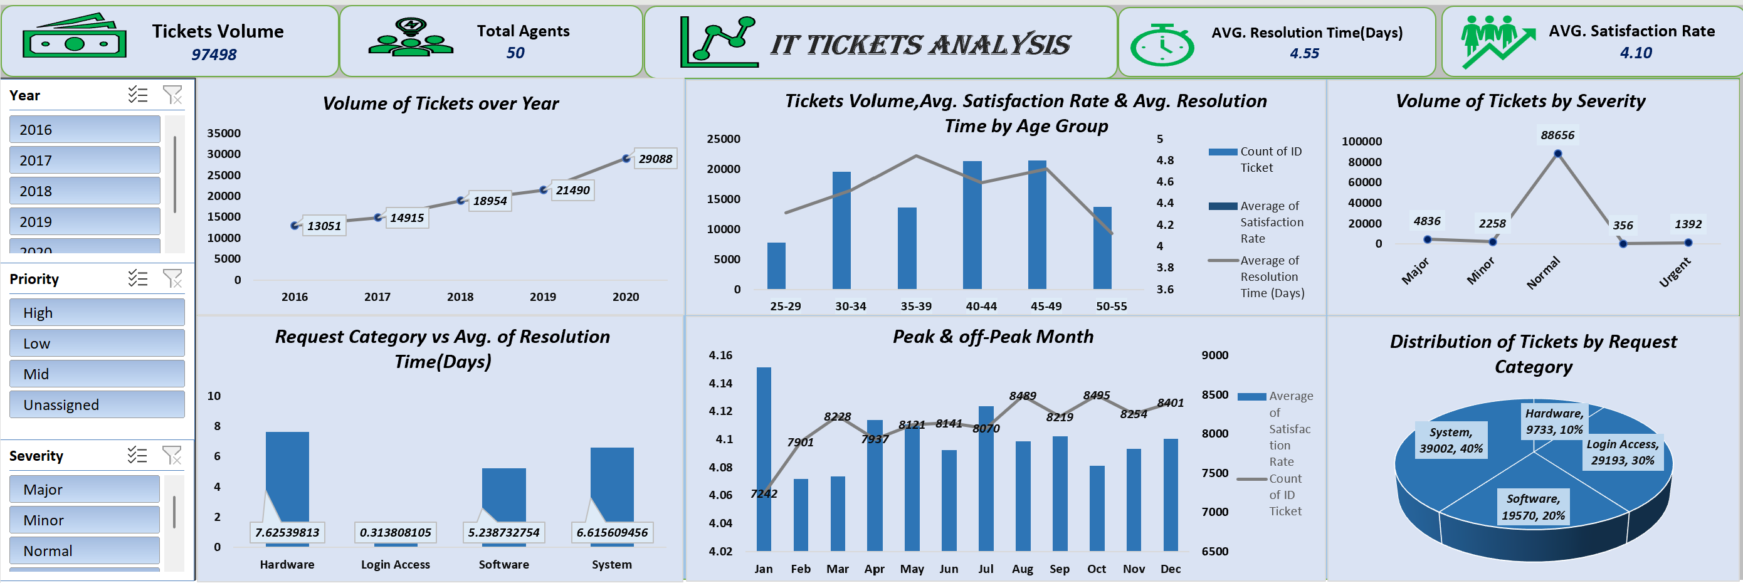
dashboard

Slide 22
CONCLUSION
In conclusion, the IT support team has managed to maintain a steady increase in customer satisfaction despite rising ticket volumes, demonstrating operational resilience. However, resolution times, particularly for hardware issues, indicate areas for improvement. By reallocating resources, providing targeted training, and
leveraging the expertise of experienced team members, efficiency can be enhanced. Investing in advanced technology and optimizing workflows will further reduce resolution times and improve service quality. With data- driven decisions and strategic resource management,
the team can continue to deliver high-quality support while adapting to growing demands.

Slide 23
Thank You

